Slide 1
Adaline filter Linear regression

Slide 2

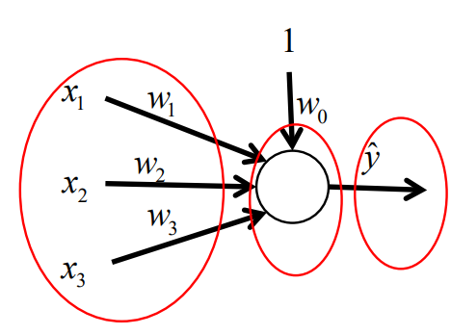
Adaline filter
Axon (Output)
Soma (Sum Point)
Dendrites (Inputs)

Slide 3
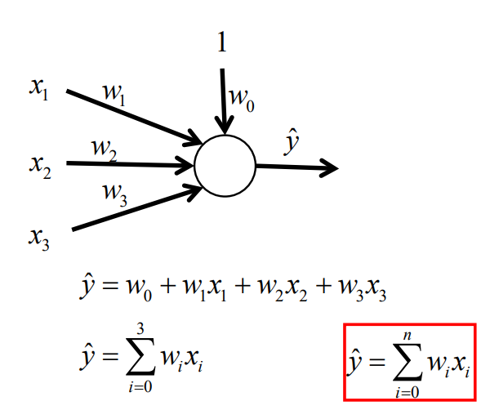
Adaline filter

Slide 4
Adaline filter
It is used to perform curve fitting.
It has the ability to enter multiple inputs.
The main objective is to determine the correct combination of weights to fit the input and the input and output data.

Slide 5
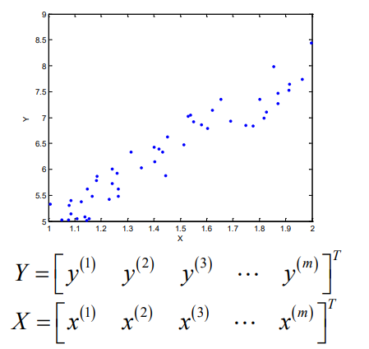
Adaline filter (linear regression)

Slide 6
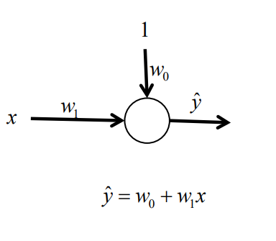
Adaline filter (linear regression)

Slide 7
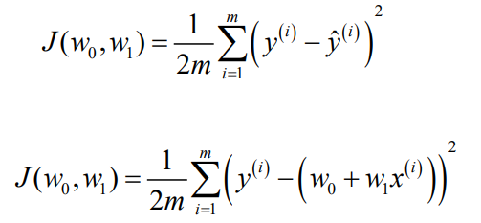
Adaline filter (linear regression)
The criteria for evaluating the proposed model

Slide 8
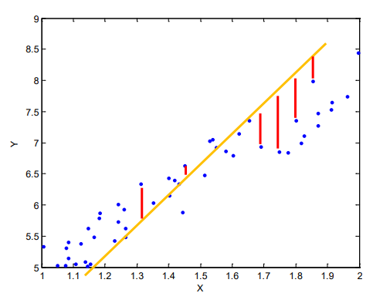
Adaline filter (linear regression)

Slide 9
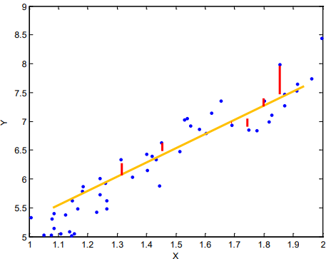
Adaline filter (linear regression)

Slide 10
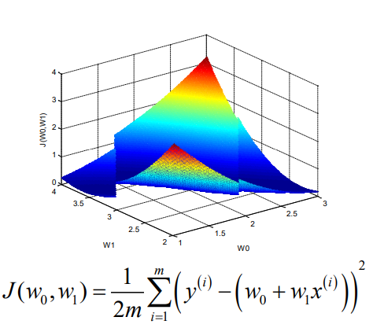
Adaline filter (linear regression)

Slide 11
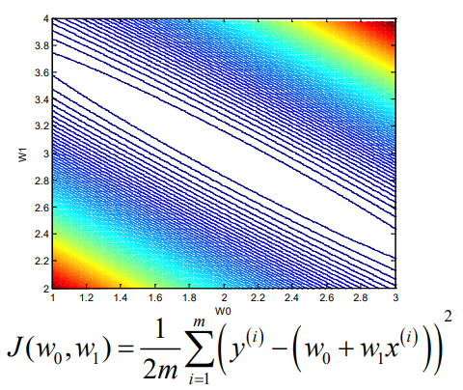
Adaline filter (linear regression)

Slide 12
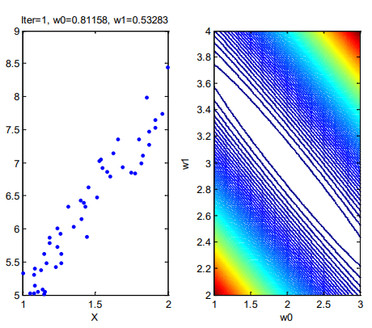
Adaline filter (linear regression)

Slide 13
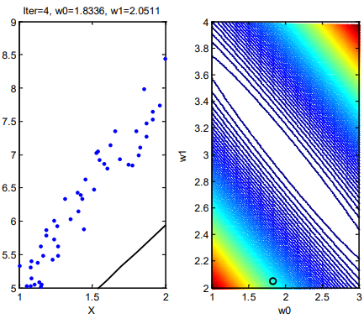
Adaline filter (linear regression)

Slide 14
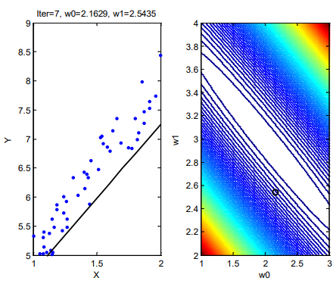
Adaline filter (linear regression)

Slide 15
Adaline filter (linear regression)
The training is carried out by means of two methods normally.
- Downward Gradient
- Least squares

Slide 16
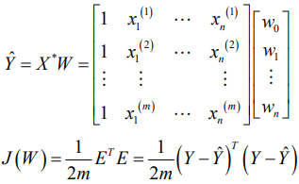
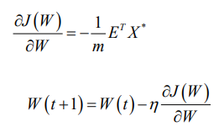
Gradient training descending
Neuronal Model
Cost Function
Gradient of cost function
Updating Law

Slide 17
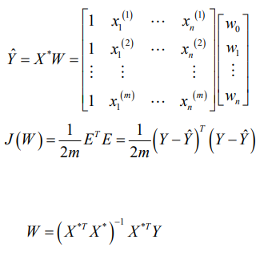
Least squares training squares
Neuronal Model
Cost Function
Obtaining weights by least squares least squares

